Slide 1
频域分析-习题讲解
2022-spring

Slide 2
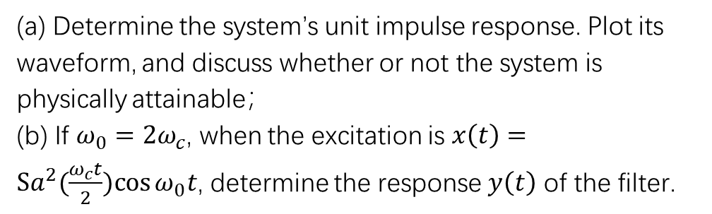
Filter-5.
(a) Determine the system’s unit impulse response. Plot its waveform, and discuss whether or not the system is physically attainable；
(b) If $ω_{0}=2ω_{c}$, when the excitation is $x\left(t\right)=Sa^{2}(\frac{ω_{c}t}{2})cos{ω_{0}t}$, determine the response $y\left(t\right)$ of the filter.

Slide 3
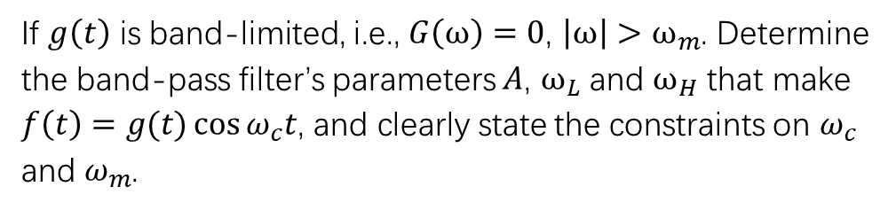

Modulation-7.
If $g\left(t\right)$ is band-limited, i.e., $G\left(ω\right)=0$, $\left|ω\right|>ω_{m}$. Determine the band-pass filter’s parameters $A$, $ω_{L}$ and $ω_{H}$ that make $f\left(t\right)=g(t)\cos{ω_{c}t}$, and clearly state the constraints on $ω_{c}$ and $ω_{m}$.
$注：画{(g(t)+cos{ω_{c}t)}}^{2} 的$频谱图！

Slide 4
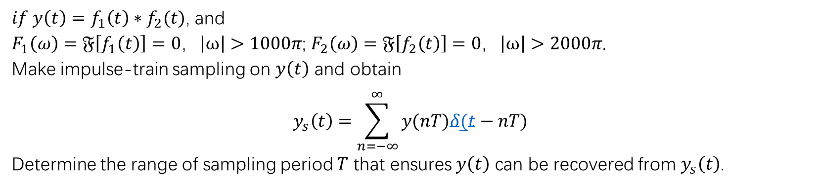
Sampling-10.
$if y\left(t\right)=f_{1}\left(t\right)∗f_{2}(t)$, and
$F_{1}\left(ω\right)=𝔉\left[f_{1}\left(t\right)\right]=0$，$\left|ω\right|>1000π$; $F_{2}\left(ω\right)=𝔉\left[f_{2}\left(t\right)\right]=0$，$\left|ω\right|>2000π$.
Make impulse-train sampling on $y\left(t\right)$ and obtain
$$y_{s}\left(t\right)=\sum_{n=−∞}^{∞}{y(nT)δ(t−nT)}$$
Determine the range of sampling period $T$ that ensures $y\left(t\right)$ can be recovered from $y_{s}\left(t\right)$.

Slide 5
Modulation-8:
SSB调制图例

Slide 6
信号分析是信号处理和传输的基础！
例：话音通信系统

Slide 7
SSB调制原理图1：
SSB调制原理图2：
边带滤波器
—Hilbert变换
上边带滤波器
下边带滤波器

Slide 9
又
则

